Slide 1
Reading for the real world:
Preparing students for a digital future

Slide 2

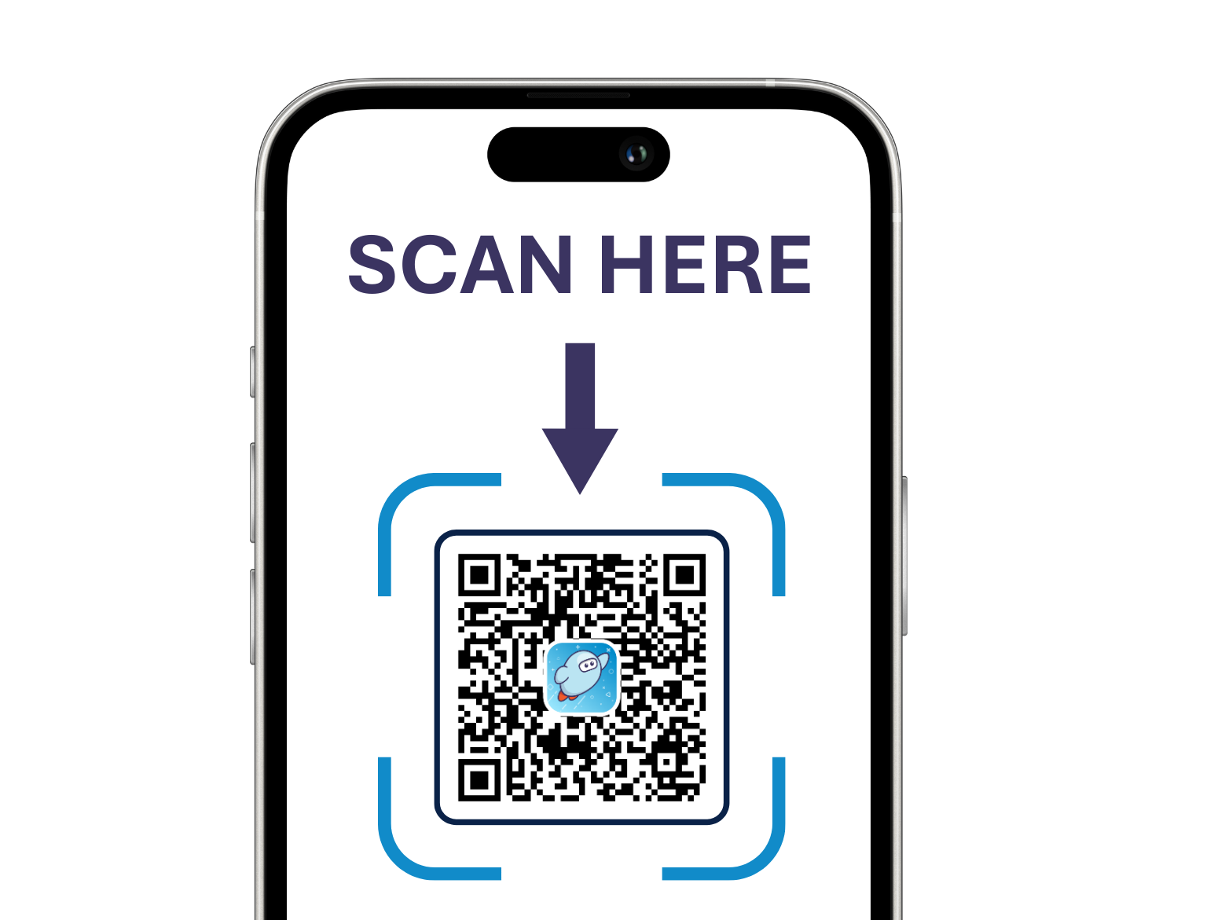


Meet your presenter: Connie Bowman
Account Executive
Phone: 216-446-0820
Email: cbowman@overdrive.com
Book time
with me!

Slide 3
Agenda
1 | Welcome & session purpose
2 | The impact of digital reading
3 | Support for every learner
4 | Spotlight: Multilingual support
5 | Takeaways & next steps

Slide 4

Audience poll: Perceptions about digital
What are some common negative perceptions about digital reading that you’ve encountered?
For example:
  Too much screentime
  It’s not “real” reading
  Students prefer print
Notes:
Today’s presentation will help dispel these misconceptions and show why digital tools are an essential component of multimodal learning and equity.
It’s not “either/or”, it’s “and”.

Slide 5
Audience poll: Perceptions about digital
Now, what are some ways we might counter those negative perceptions?
Notes:
Today’s presentation will help dispel these misconceptions and show why digital tools are an essential component of multimodal learning and equity.
It’s not “either/or”, it’s “and”.

Slide 6

Let’s discuss
The impact of digital reading on all students
What if you could provide equitable access resources?
What if you could provide one platform for your learning community?
What if you could support all readers where they are?
Notes:
What if you could provide equitable access resources
What if you could provide one platform for your learning community
What if you could support all readers where they are

Slide 7

Let’s discuss:
What if you could reflect students’ languages and cultures with
inclusive resources?
What if you could offer built-in tools
and customization options to help readers access and engage with
grade level content?
What if there was a single platform offering the content, format, and tools to meet these readers’ unique literacy needs and skills?

Slide 8
The impact of digital reading

Slide 9
Consider:
How much time do you spend reading on screens every day?

Slide 10



Prepare all students for the future
Deep, sustained
digital reading
Vocabulary development
Text interaction and comprehension
Notes:
Self-paced learning/independent exploration
Higher-order thinking
Advanced vocab and comprehension
Visual/auditory integration
Access to diverse content/Interactive learning

Slide 11


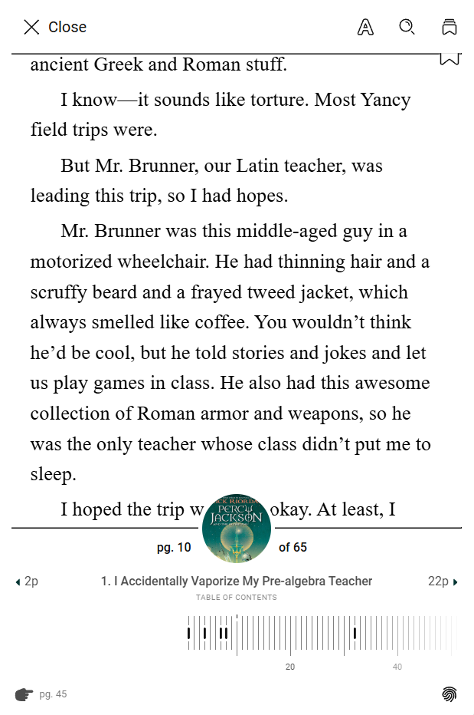

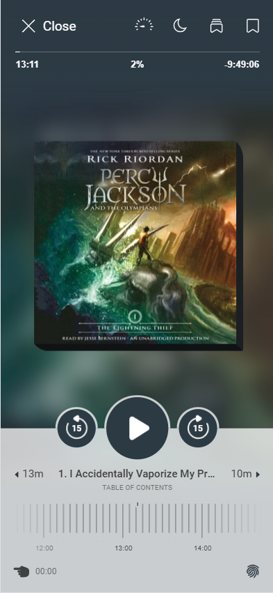
Build equity
24/7 access to ebooks and more,
in school and at home
One platform for short-form, long-form, and audio resources
Equitable access across schools
and community
Notes:
Sora is available when library or school building is closed
Everything lives in one place - no need to gather outside resources
Students see themselves reflected in collections
Every school has the same base collection and by sharing you can have more copies of the high demand titles and less of the ones that circulate less. This ensures that everyone finds what they want to read and don't have to wait very long for the high demand titles.
Low-income homes don't have access to many books - this helps drive equity and level the playing field a bit more

Slide 12
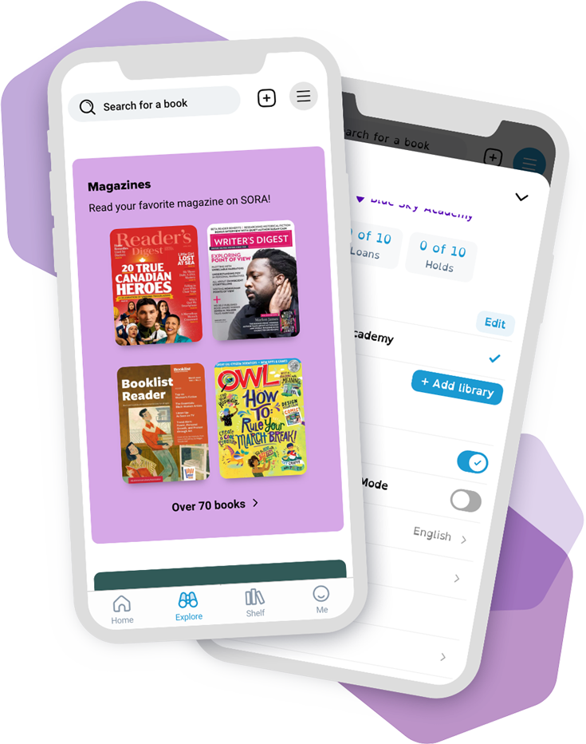
Meet the needs of all students
A single platform for all learners
Multiple modes of reading
A private and personalized experience for every reader
Notes:
Single platform that supports all readers
Font changes can impact student's willingness to read a book - ever pick up a book and put it down

Slide 13
Demo 1 – login experience
Notes:
Open the library, show 24/7 access, search, and borrowing in one place.

Slide 14

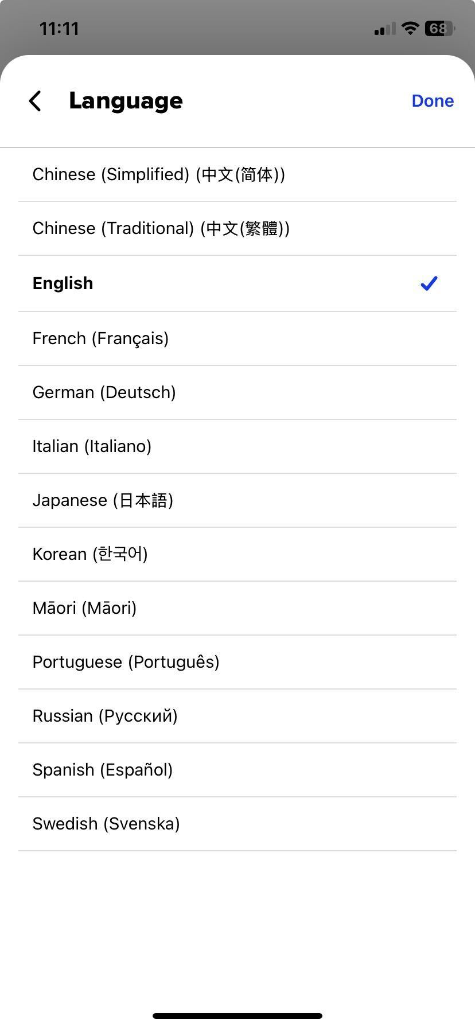
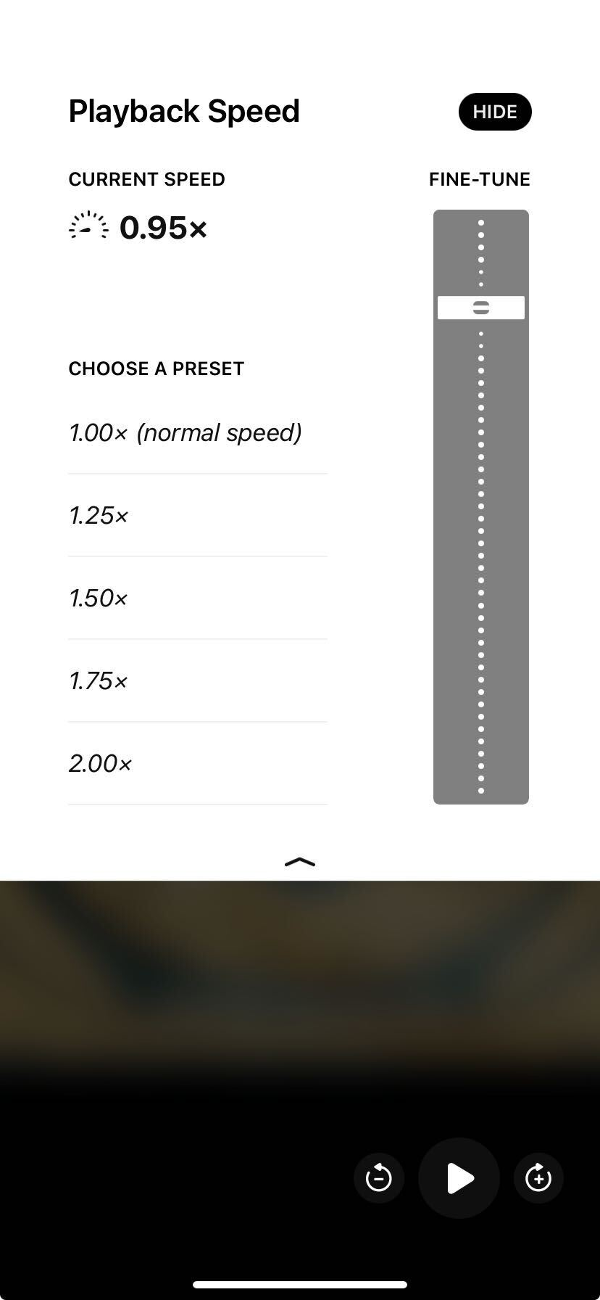
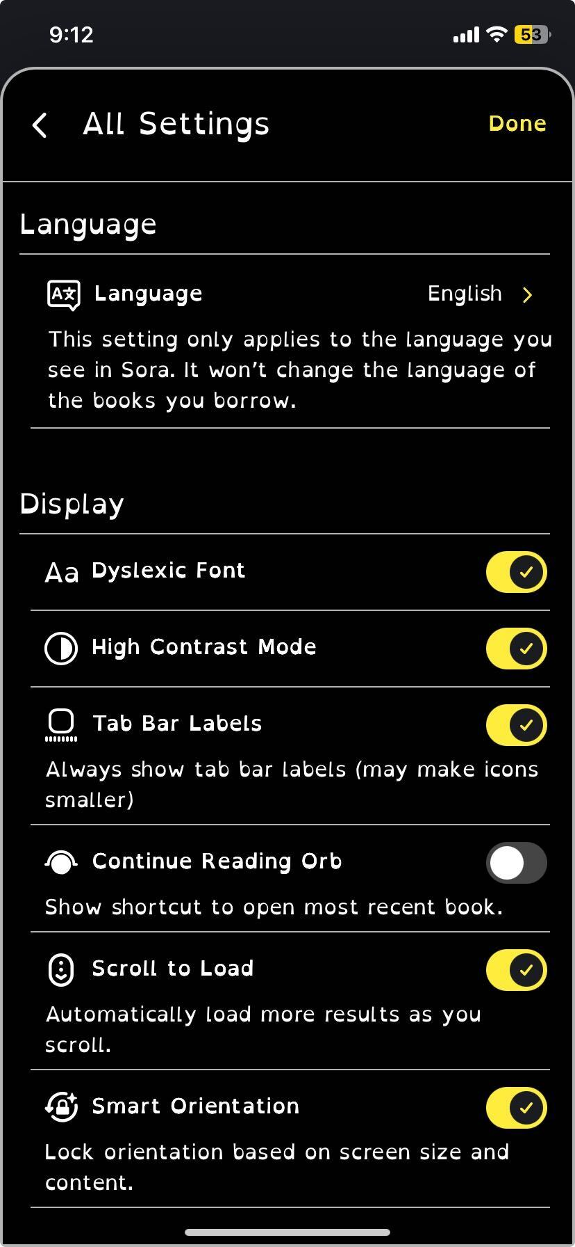
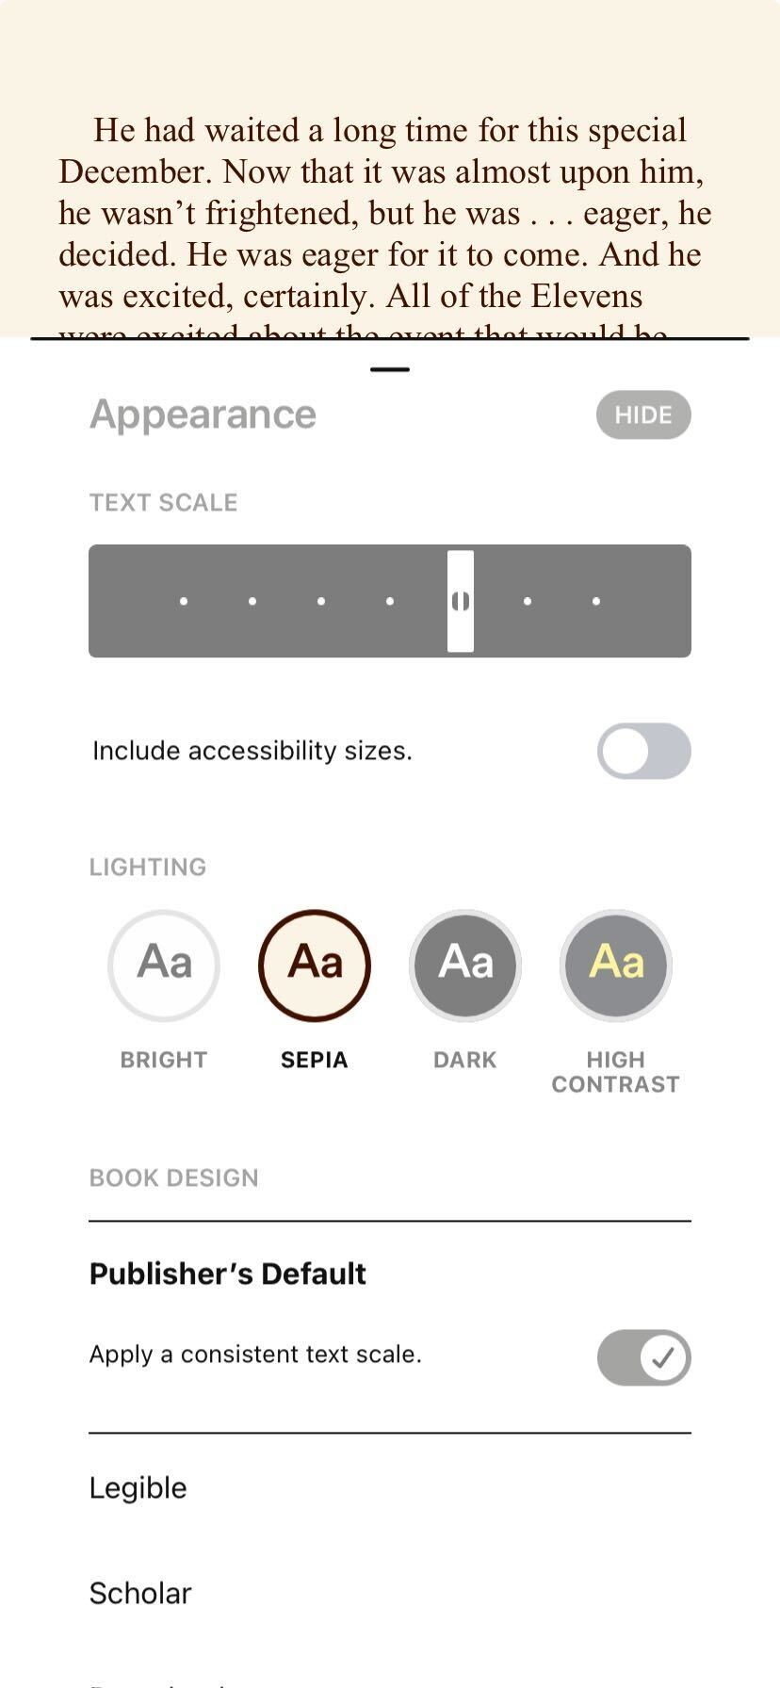

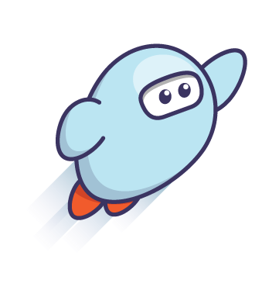
Personalize every learner’s reading experience
Customizable reading interface
Adjustable settings
Minimized distractions
Integrated reading data
Notes:
Customizable reading interface
Customization supports cognitive load theory. Learners who control their environment allocate more mental resources to comprehension rather than decoding.
Students can modify text scale, line spacing, and justification to reduce visual strain, improve comfort, and even find crossover benefits for students with special needs.
Options like dark mode and font weight adjustments help sustain attention during extended reading sessions.
Adjustable settings
Multilingual interface and adjustable audiobook speeds
A multilingual interface can reduce language barriers and instead foster student inclusion and even family engagement.
Adjustable playback speeds support fluency development and processing time, something that research shows is critical for second-language learners (comprehensible input at the right pace accelerates acquisition).
Minimized distractions
Sora's reading environment minimizes distractions, which can improve learning outcomes for language learners because it enhances focus and reduces the cognitive load. (Note: Technically, it can improve learning outcomes for all–this isn't specific to the MLL audience, but it's still valid.)
Unlike print, digital platforms can streamline navigation and eliminate clutter, allowing learners to focus on text and audio integration.

Slide 15
Leverage tools that support diverse learning needs
Built-in tools to support all readers
Custom reading experience
Access to high-interest content across formats and reading levels
Notes:
Define, pronounce, translate, and read to me
Building vocabulary is a huge part of academic success and having the tools to custom support for learning new vocab is built into Sora
Not all kids qualify for specialized services, yet they would benefit from having access to all of the custom tools in Sora. Font changes, audiobooks etc.
The more access to books students have the more likely they are to read which impacts overall academic success.
How often do you open a book and put up because the font is too small or isn't easy to read?
How often to have to read the same passage twice - would it help to have it read to you?

Slide 16
Demo 2 – personalization/reading tools
Notes:
Toggle display settings (font, spacing, themes) and show how these adjustments can extend reading stamina/differentiate based on every student’s needs; show learning tools – notes/highlights, definitions and pronunciations/text-to-speech, translations

Slide 17

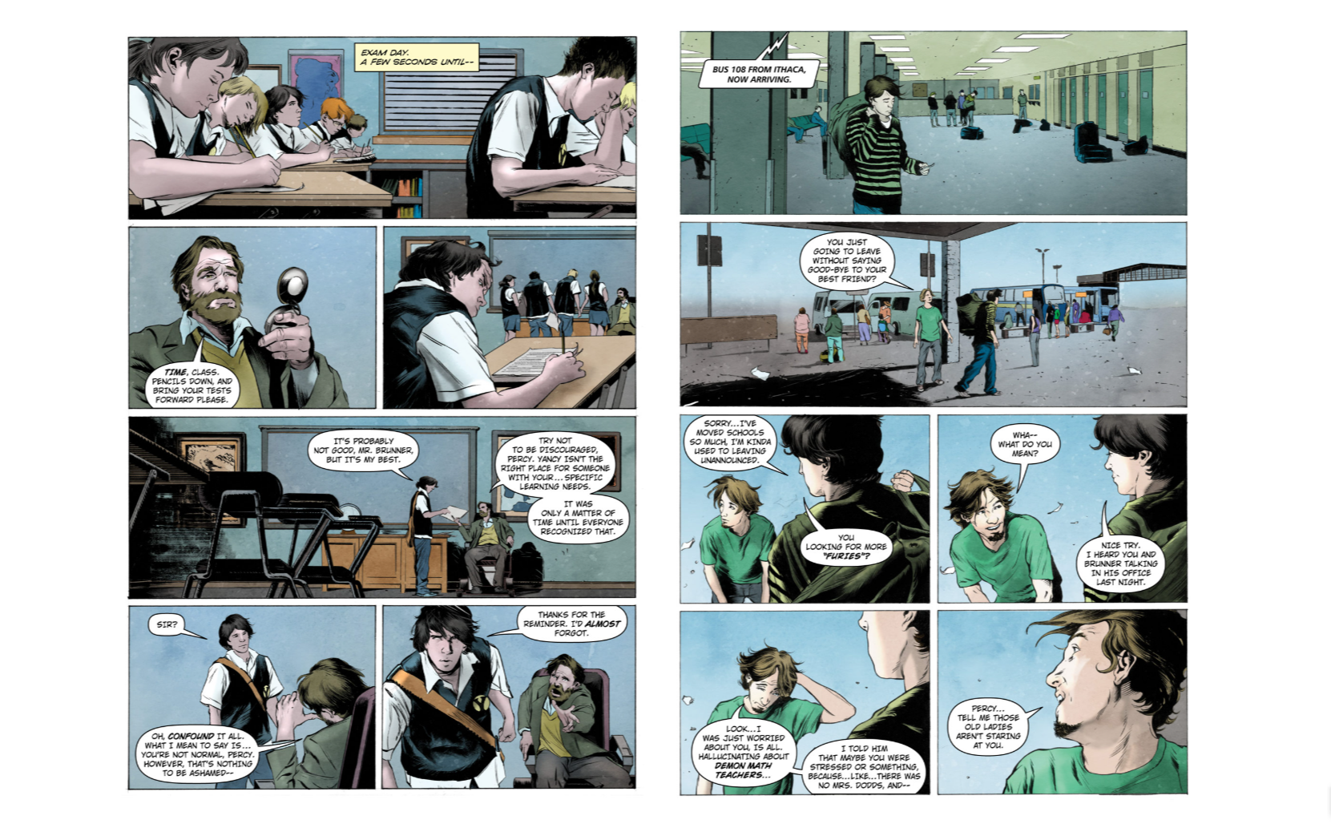
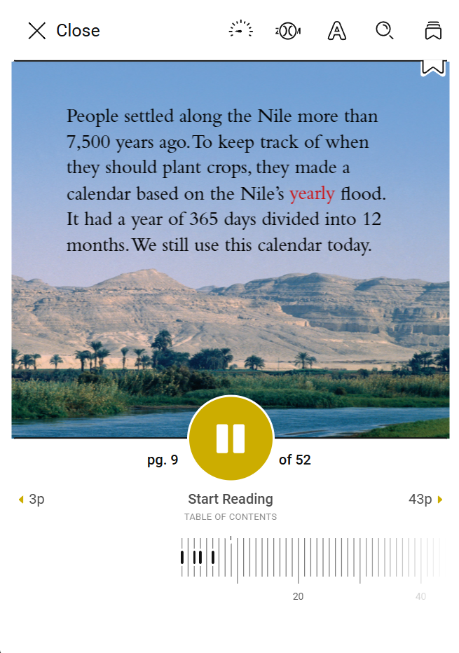
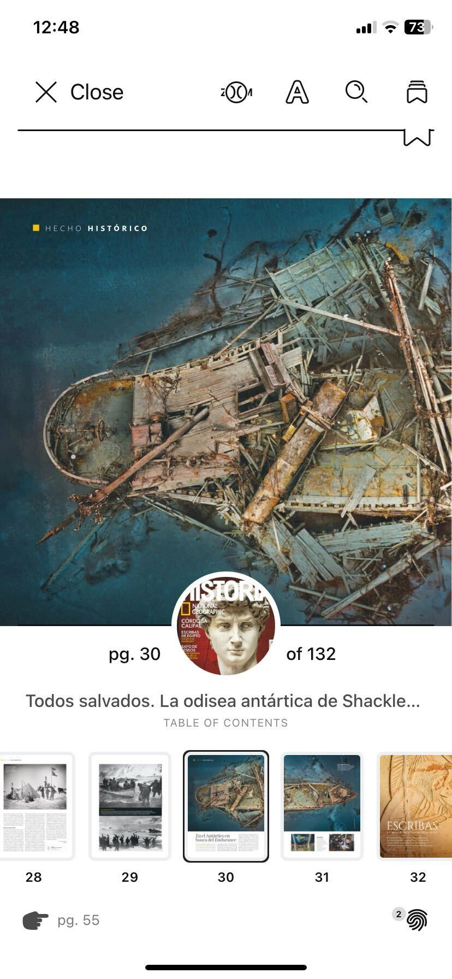
Spotlight formats that engage all readers
High-low texts, graphic novels,
and comics
Audiobooks and Read-Alongs
Engaging magazines for leisure reading and curricular alignment
Notes:
High-low texts, graphic novels, and comics
High-low texts provide age-appropriate themes with accessible language, reducing frustration and building confidence.
Graphic novels and comics leverage dual coding theory (text + visuals) to support comprehension and vocabulary acquisition.
Visual storytelling helps learners decode meaning and infer context, which accelerates language development.
Audiobooks and Read-Alongs
Audiobooks model fluent reading and authentic pronunciation, supporting phonological awareness and listening comprehension.
Read-Alongs combine text and audio, reinforcing decoding skills while providing immediate feedback for accuracy.
Engaging magazines for leisure reading or curricular alignment
Magazines offer high-interest, real-world content that motivates voluntary reading (a key predictor of language growth).
Current magazine issues connect classroom learning to relevant, authentic contexts, fostering relevance and engagement.
Short, rich articles reduce cognitive load and support language learners with manageable amounts of text.

Slide 18
Sora supports every learner

Slide 19
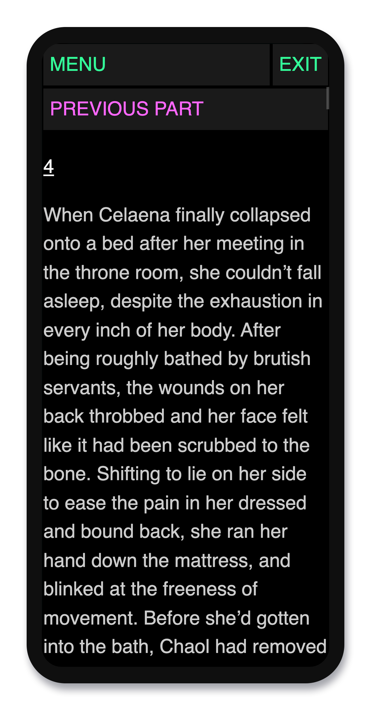
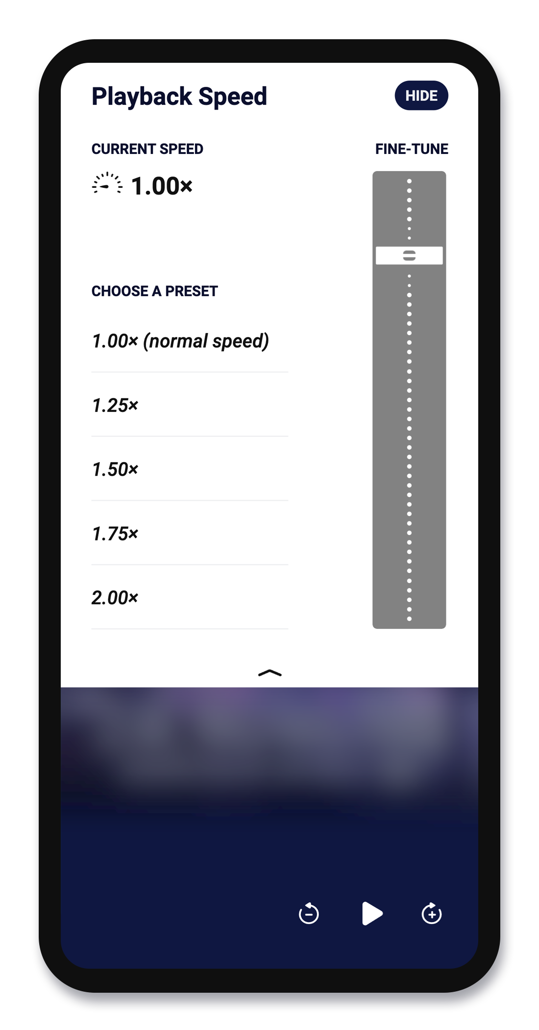
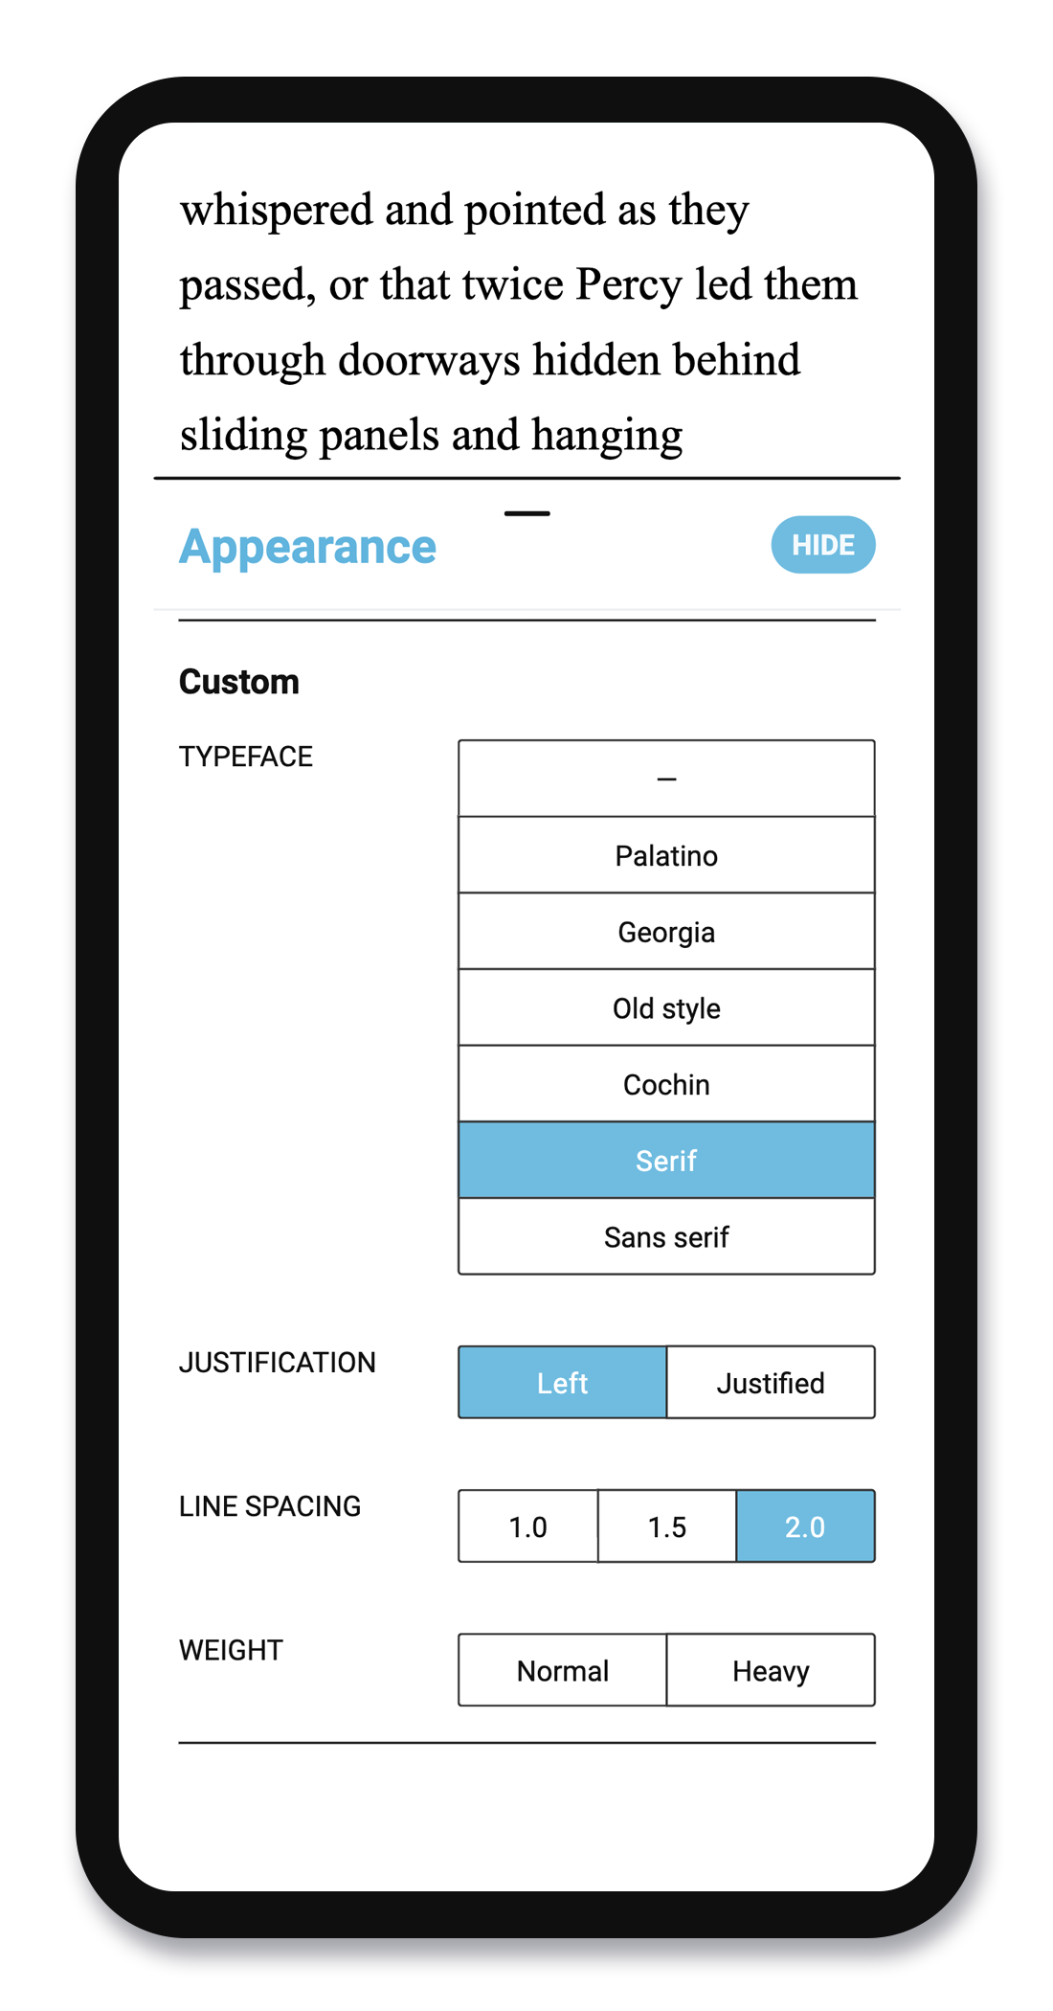
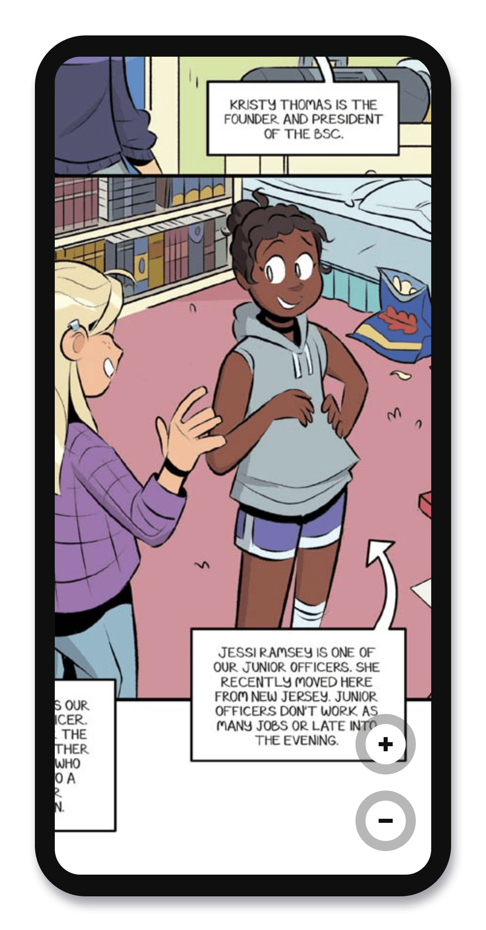





Support specialized populations
Special Education
Professionally-narrated audiobooks
with speed controls
Customizable settings to personalize the reading experience
Read to Me and screen reader compatibility
Notes:
Stops othering students - if they need a large print book, audio book, graphic novel, dyslexic font it is all in one place
Audiobooks keep students reading and engaged with grade level content even when they struggle to read it in print form.
Quick support when students reach a challenging passage.

Slide 20
Support specialized populations
Gifted & Talented
Cross-curricular learning opportunities
"Sticky" notes: annotations and definitions stay with the student, not the book, for ongoing access beyond due dates
Deep learning and digital
skill development
Notes:
Encourage self-directed learning
Offer advanced tools (annotations, etc.) for advanced thinkers
Offer privacy from the stigma for reading/learning in advance of their peers
Offer multilingual, higher-level, or research-based texts in the same app

Slide 21
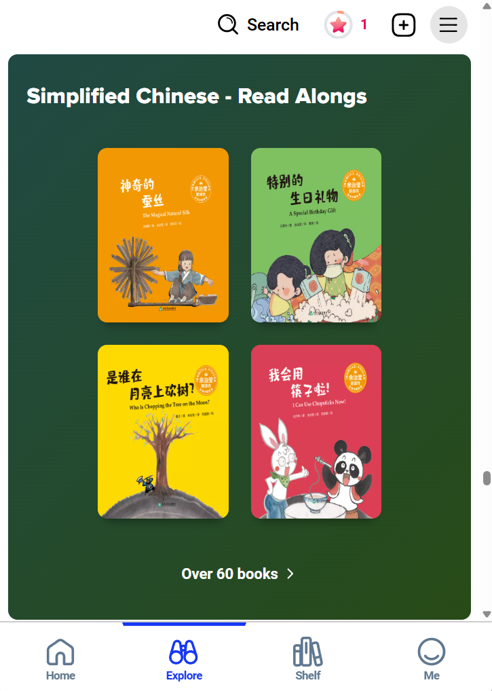
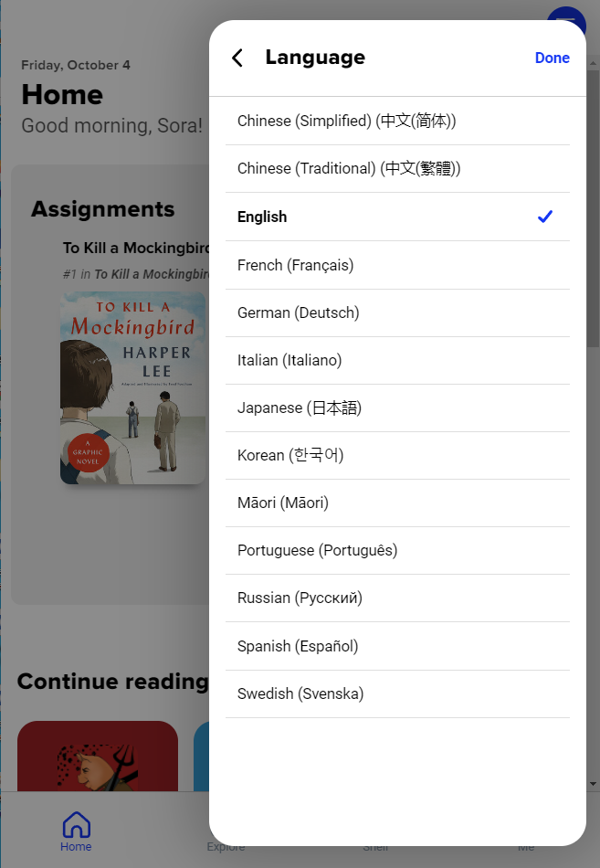
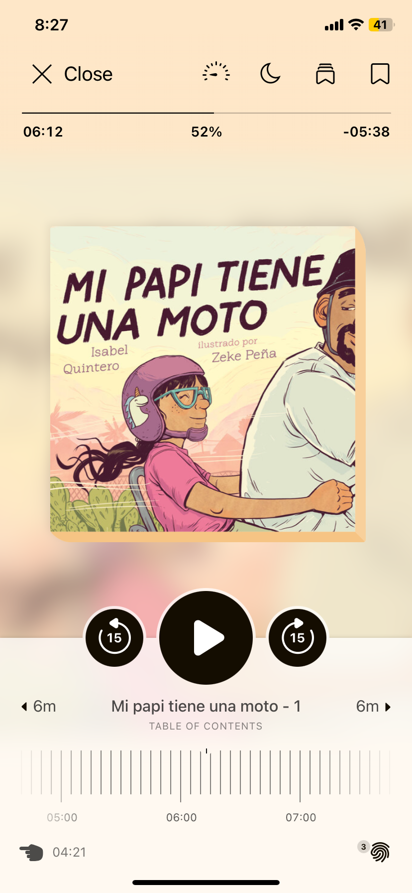
Support specialized populations
Multilingual Learners &
English Language Learners
Multilingual collection and app support
Professionally narrated audiobooks with adjustable playback speed
Built-in access to Google Translate
Notes:
Helps include families that don't speak English in the education process. They can help students navigate the platform and even read books in their native language.
Speeds up language acquisition by listening
Controlling the speed of playback ensures that students have time to process the spoken word
Audiobooks help students read grade level content that would been difficult for them to read in print/ebook formats

Slide 22
Spotlight: Multilingual support

Slide 23
Common misconceptions about multilingual learners (MLL)
With appropriate support, scaffolding, and differentiation, MLLs can:
  Learn content before mastering English
  Complete grade-level work while acquiring new language skills
Notes:
MLL students can learn content before mastering English when they have the proper support.
Language acquisition is not a barrier to grade-level work; scaffolding and differentiation make it possible.
Misconceptions can hinder progress. Science-backed strategies accelerate learning.

Slide 24

Deliver science-backed support for language development
Authentic spoken language modeling
Diverse, leveled texts
Vocabulary growth tools
Integrated reading data
Notes:
Authentic spoken language modeling
Sora's audiobook and Read-Along offerings model authentic spoken language–and not just in English, but many languages.
Impactful for emerging speakers, dual immersion students, and learners looking for enrichment opportunities.
Content is professionally narrated by real humans (not AI); this professional narration supports comprehension and pronunciation.
Plus, text-to-speech lets learners hear words while following along visually, reinforcing phonological awareness.
Professional narration supports listening comprehension and pronunciation.
Vocabulary and comprehension growth:
Sora simplifies active reading: readers can look up words instantly, take notes to provide context for new vocabulary, and create personal word banks for review.
Diverse, leveled texts mean easy scaffolding and differentiation: language learners can start with simpler texts before progressing to more complex narratives.
Teachers can monitor engagement through integrated reading data, helping them identify targeted intervention opportunities–opportunities that are often missed when using only print books.
Vocabulary growth tools: Instantly look up words, take notes, and create personal word banks.
Teachers can monitor engagement and intervene early using integrated reading data.

Slide 25

Provide equitable access through a single platform
Collections of diverse content, accessible on any device
Multilingual app interface and help resources to keep families engaged
Filtering options for language, reading level, interest level, and more
Notes:
Collections of diverse content, accessible on any device
With Sora, schools can provide thousands of titles in multiple languages into a single, easy-to-use platform. No need to juggle multiple vendors or systems.
Every student, regardless of language background, can access high-quality reading materials that support literacy and language development.
Parents can read alongside their children in their home language, strengthening school-home connections and supporting biliteracy.
Interface available in multiple languages to keep families engaged
Switching languages is simple, so families feel confident and empowered to support learning at home.
A multilingual interface signals that your district values diversity and inclusion, fostering trust and engagement.
Filtering options for language, reading level, interest level, and more
Teachers and students can quickly find books that match language needs, grade level, and personal interests.
Teachers can curate collections or even assign titles to guide students to curricular titles, eliminating the guesswork.
Simplify differentiation and support IEPs by using filters to find the right content for the right learners.
When learners can select books that interest them in their preferred language, engagement and reading stamina increase.

Slide 26
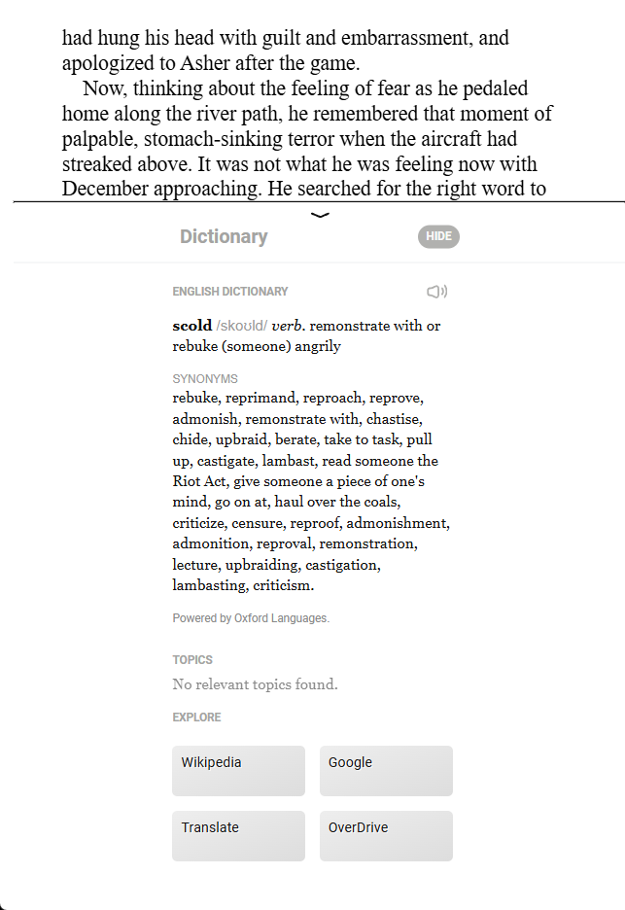
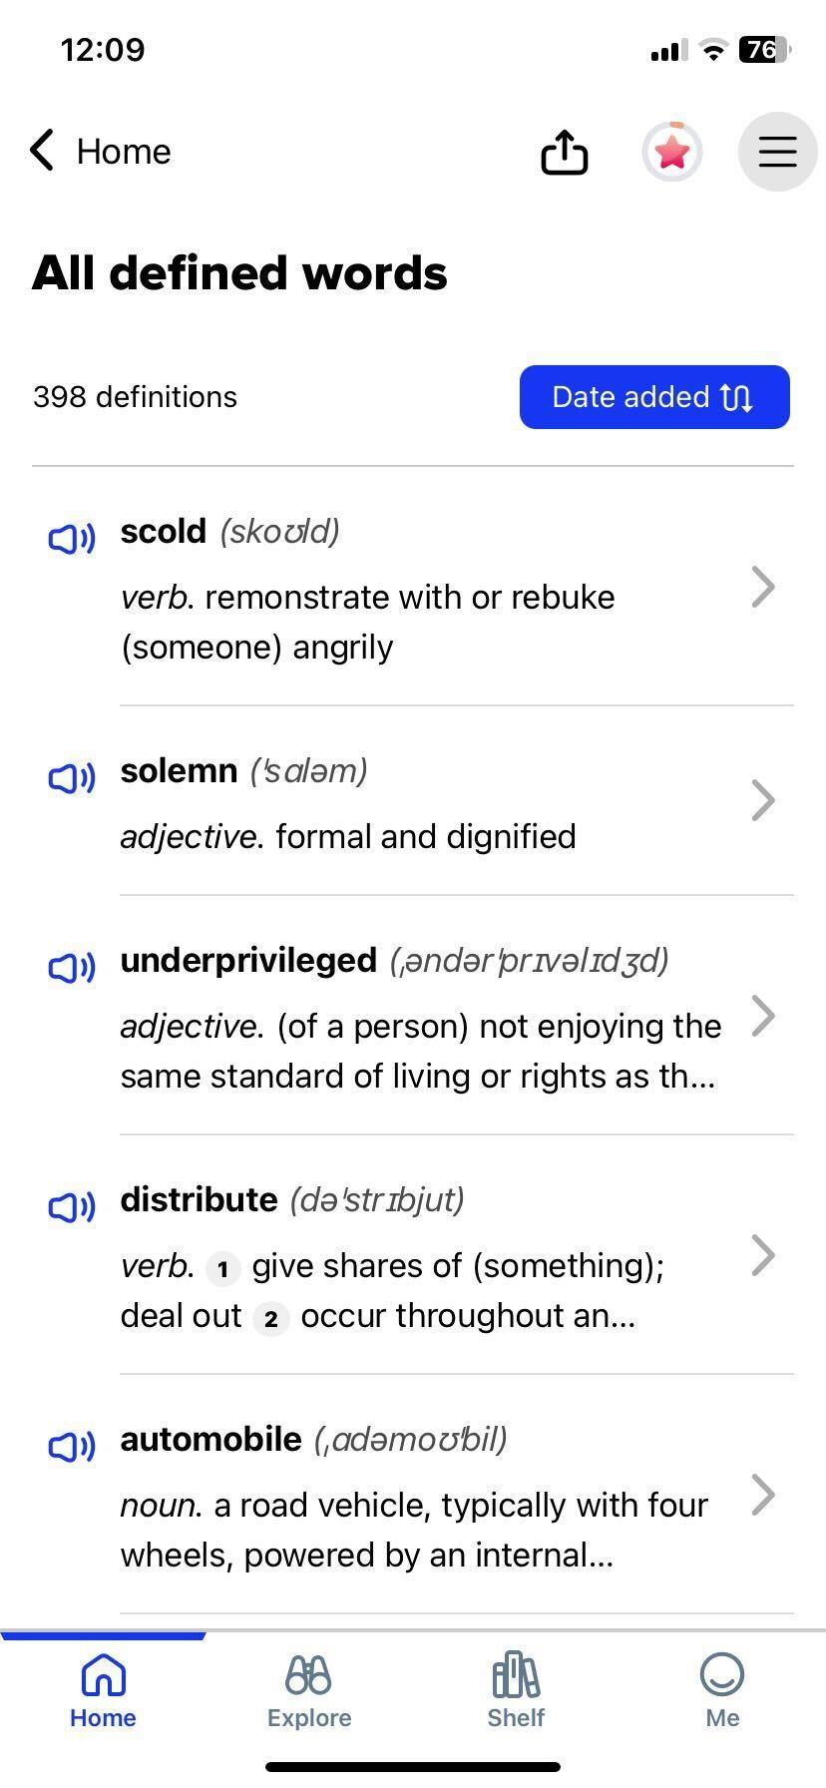
Equip learners with language-building tools
In-app dictionary
Pronunciation and translation tools
Active listening and fluency building
with audio formats
Notes:
In-app dictionary
Sora's in-app dictionary helps students with instant access to definitions and more.
Plus, Sora retains a list of defined words for ongoing language growth.
Immediate access to definitions means sustained reading. According to research, uninterrupted reading flows improve comprehension and retention.
Pronunciation and translation tools
Sora's auditory pronunciations can help students improve phonological awareness and reinforce accurate articulation
Translation tools provide comprehensible input, which helps students connect new words to their first language.
Hearing words in both languages reinforces dual coding theory.
Active listening and fluency building with audio formats
Boost oral language development by modeling fluent reading and authentic intonation.

Slide 27
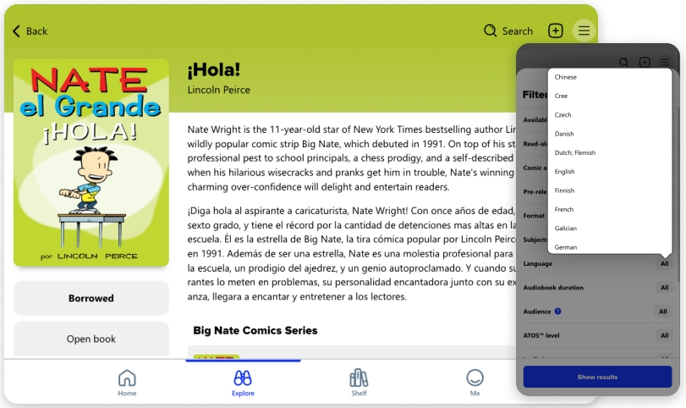
Offer content that reflects students’ identities
Authentic texts in heritage languages
Translations of popular titles
loved by peers
Books at varied reading levels
to meet learners where they are
Notes:
Authentic texts in heritage languages
Access to authentic texts supports biliteracy development, which can strengthen flexible thinking and academic achievement.
Authentic texts also validate students' backgrounds and personal experiences, affirming their identities.
Popular translations of peer-favorite titles.
Translations of popular content can reduce feelings of isolation, creating more social connection opportunities for MLLs.
Books at varied reading levels to meet learners where they are.
You can build a collection that reflects your school community with culturally relevant titles in multiple languages. This supports biliteracy, and more importantly, student agency. A wide selection of materials encourages student choice, fostering a key factor in language acquisition: intrinsic motivation.
Differentiated texts allow learners to progress from simpler to more complex language structures, helping educators appropriately scaffold for language acquisition–all in the same app other readers are using.

Slide 28
Demo 3 – language tools
Notes:
Interface, search filters for different languages

Slide 29
Takeaways and next steps

Slide 30
You are walking away with…
Ways to build equity and access with an all-in-one platform offering multimodal reading and resources.
Contact your
Sora team
Notes:
What you saw today was a single platform supporting all learners, providing equity and access to all readers.
Insert next action step – the ask…

Slide 31

You are walking away with…
One platform that supports students and families in building long-term literacy skills.
Contact your
Sora team
Notes:
Insert next action step – the ask…
Ask for the next step/meeting.

